Slide 1

UNIVERSITY COLLEGE OF ENGINEERING KANCHEEPURAM COMPUTER SCIENCE AND ENGINEERING
STOCHASTIC GRADIENT DESCENT BASED HATE SPEECH DETECTION IN SOCIAL NETWORKS
BATCH MEMBERS :
1. GOKUL S (513419104015)
2 HARIPRAKASH M (513419104017)
3.KISHORE KUMAR M (513419104023)
GUIDED BY –Mrs.T.Kala M.E(PhD)
Assistant Professor, Dept. of CSE

Slide 2
ABSTRACT
The detection of hate speech in social media is a crucial task.
The uncontrolled spread of hate has the potential to gravely damage our society, and severely harm marginalized people or groups.
As online content continues to grow, so does the spread of hate speech.
The Project identifies and examine challenges faced by online automatic approaches for hate speech detection in text.
Among these difficulties are subtleties in language, differing definitions on what constitutes hate speech, and limitations of data availability for training and testing of these systems.

Slide 3
INTRODUCTION
Hate speech detection is the task of detecting if communication such as text and so on contains hatred and or encourages violence towards a person or a group of people.
This is usually based on prejudice against 'protected characteristics' such as their ethnicity, gender, sexual orientation, religion, age et al.
The automatic detection of hate speech is a challenging task due to disagreements on different hate speech definitions.
Therefore, some content might be hateful to some individuals and not to others, based on their concerned definitions.

Slide 4
AIM / OBJECTIVE
Hate speech is a big problem on the internet. It can be found on social media, in comment sections, and even in online forums.
Machine learning algorithms can be used to detect hate speech.
These algorithms can analyze text and identify hate speech.
They can also be used to determine the tone of a text.
This can be used to identify hate speech that is disguised as jokes or sarcasm.
This project uses Machine learning algorithm and NLP to detect the hate speech.

Slide 5
OBSERVATION/MOTIVATION
The nature of social media means that anyone can post anything they desire, putting forward any position, whether it is enlightening, repugnant or anywhere between.
Depending on the forum, such posts can be visible to many millions of people.
Hate-speech is an important aspect of this inappropriate content.
Hate-speech is a subjective and complex term with no single definition, however. Irrespective of the definition of the term or the problem, automated methods for detecting hate-speech are necessary in some circumstances.

Slide 6
EXISTING SYSTEM
The machine learning algorithms that can be used to detect hate speech include
Naive Bayes
Support Vector machines (SVM)
Extreme gradient boosting (XGBoost)
Multi-layer perception (MLP)
Traditional text classification methods based on machine learning have many disadvantages such as dimension explosion, data sparsity, limited generalization ability.

Slide 7
LITERATURE REVIEW (CONT..I)
S.NO | TITLE | AUTHOR NAME | YEAR & PUBLICATION | CONTEXT
1. | Cross-Lingual Few-Shot Hate Speech and Offensive Language Detection Using Meta Learning | Marzieh Mozafari; Reza Farahbakhsh; Noel Crespi | 2022 & IEEE | Experiments show that meta learning-based models outperform transfer learning-based models in most cases, and that Proto-MAML is the best performing model, as it can quickly generalize and adapt to new languages
2. | Hate Speech Detection using Machine Learning | P. Preethy Jemima; Bishop Raj Majumder; Bibek Kumar Ghosh; Farazul Hoda | 2022 & IEEE | Data from social media sites such as Twitter are used to test the effectiveness of these procedures, and they reveal a 6-percentage point improvement in macro-average F1 or a 9 percent improvement for content that has been labeled as hateful, respectively.

Slide 8
LITERATURE REVIEW (CONT..II)
S.NO | TITLE | AUTHOR NAME | YEAR & PUBICATION | CONTEXT
3. | PDHS: Pattern-Based Deep Hate Speech Detection With Improved Tweet Representation | P. Sharmila; Kalaiarasi Sonai Muthu Anbananthen; Deisy Chelliah; Sudhaman Parthasarathy; Subarmaniam Kannan | 2022 & IEEE | The experimental results on Twitter Dataset can learn effective features to enhance the performance with minimum training time and attained 88%F1Score.
4. | Deep Learning Based Fusion Approach for Hate Speech Detection | Yanling Zhou; Yanyan Yang; Han Liu; Xiufeng Liu; Nick Savage | 2020 & IEEE | The ExperimeNt shows that the accuracy and F1-score of the classification are significantly improved.

Slide 9
PROPOSED WORK
This project uses SGD for hate speech classifications. SGD stands for Stochastic Gradient Descent .
Stochastic Gradient Descent (SGD) is a variant of the Gradient Descent algorithm used for optimizing machine learning models. In this variant, random training example is used to calculate the gradient and update the parameters at each iteration.
SGD is still computationally much less expensive than typical Gradient Descent. Hence, in most scenarios, SGD is preferred over Batch Gradient Descent for optimizing a learning algorithm.

Slide 10
SYSTEM REQUIREMENTS
Software Requirements:
Hardware Requirements:
Python
Prefered IDE
Necessary Modules
LAPTOP WITH 2GB RAM

Slide 11
LIST OF MODULES
Proposed System consists of three module phases:
Phase 1
Data gathering
1.Kaggle
Data preprocessing
1.TF-IDF
2.Count Vectorization
3.Punctuation Removal

Slide 12
MODULES
Phase 2
choose a model
1.Stochastic Gradient Method
2.Long short-term memory(LSTM)
3.Convulational neural networks(CNN)
4.Bi-directional LSTM

Slide 13
MODULES
Train the model
1.SSD (Single shot detector)
Phase 3
Evaluate model
1.Precision
2.Recall
3.F-1 Score

Slide 14
SYSTEM ARCHITECTURE
Pre processing
Lower case
Converting text to float
Count vector
Text input
Punctuation remover
TF-IDF
Test data
Model
SGD Algorithm
Training Data
Output

Slide 15
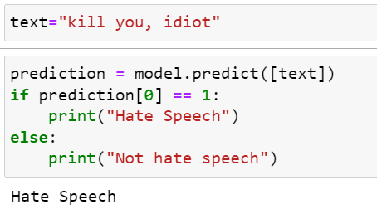
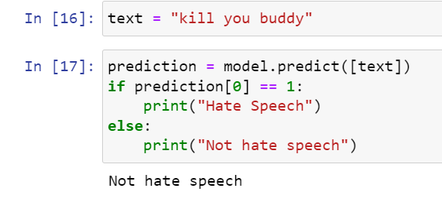
EXPECTED OUTCOME
Not Hate Speech
Hate Speech

Slide 16
CONCLUSION
As hate speech continues to be a societal problem, the need for automatic hate speech detection systems becomes more apparent.
We presented the current approaches for this task as well as a new system that achieves reasonable accuracy.
We also proposed a new approach that can out perform existing systems at this task, with the added benefit of improved interpretability.

Slide 17
REFERENCES ( CONT.. I)
P. K. Jain, V. Saravanan, and R. Pamula, ‘‘A hybrid CNN-LSTM: A deep learning approach for consumer sentiment analysis using qualitative usergenerated contents,’’ ACM Trans. Asian Low-Resource Lang. Inf. Process., vol. 20, no. 5, pp. 1–15, Sep. 2021.
A. Kamaal and M. Abulaish, ‘‘CAT-BiGRU: Convolution and attention with bi-directional gated recurrent unit for self-deprecating sarcasm detection,’’ Cognit. Comput., vol. 14, pp. 91–109, Jan. 2021.
P. K. Jain, R. Pamula, and E. A. Yekun, ‘‘A multi-label ensemble predicting model to service recommendation from social media contents,’’ J. Supercomput., vol. 66, no. 1, pp. 1–20, Sep. 2021.

Slide 18
REFERENCES(CONT.. II)
E. W. Pamungkas, V. Basile, and V. Patti, ‘‘A joint learning approach with knowledge injection for zero-shot cross-lingual hate speech detection,’’ Inf.Process. Manage., vol. 58, no. 4, pp. 1–19, 2021.
K. Miok, B. Skrlj, D. Zaharie, and M. Robnik-Sikonja, ‘‘To ban or not to ban: Bayesian attention networks for reliable hate speech detection,’’ Cognit. Comput., vol. 21, no. 1, pp. 1–19, 2021.
S. Kiritchenko, I. Nejadgholi, and K. C. Fraser, ‘‘Confronting abusive language online: A survey from the ethical and human rights perspective,’’ J. Artif. Intell. Res., vol. 71, pp. 431–478, Jul. 2021

